Slide 1

Machine Learning Project 1
Predicting Heart Disease using Machine Learning Techniques: A Comparative Analysis
Course: Machine Learning 40430
Group: 116723 Josip Ivančević, 116656 Nikolas Recke
Aveiro, 2023
HCI 2022-2023

Slide 2
Introduction
Predicting Heart Disease using Machine Learning Techniques: A Comparative Analysis
Leading cause of morbidity and mortality worldwide.
17.9 million deaths yearly from CVDs*
Early diagnosis is crucial for better patient outcomes.
Transforming healthcare through data-driven insights.
Enabling early detection and prevention of diseases.
Analyzing complex datasets and predicting heart disease.
Identifying hidden patterns for improved patient care.
* CVDs - Cardiovascular diseases
HCI 2022-2023
‹#›

Slide 3
Table of content
Predicting Heart Disease using Machine Learning Techniques: A Comparative Analysis
Introduction
Dataset Description
Data Preprocessing
Models
Model Selection and Hyperparameter Tuning
Model Performance Metrics
Comparison of Models
Comparison With Other Work
Discussion and Conclusion
References
HCI 2022-2023
‹#›

Slide 4
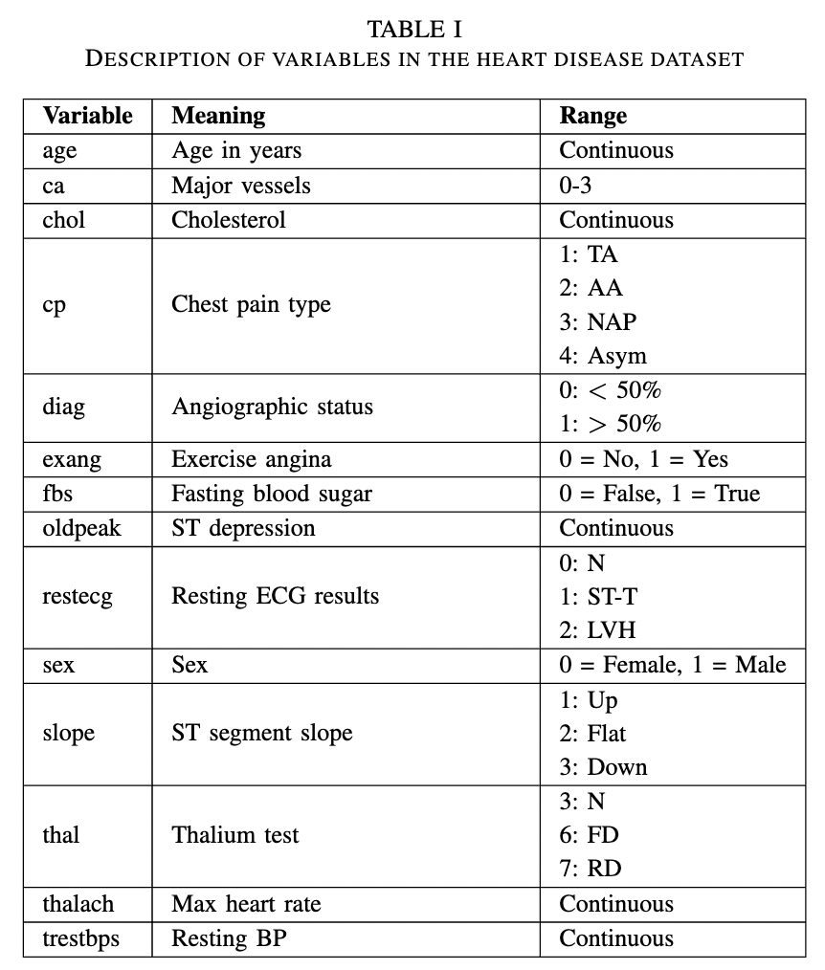
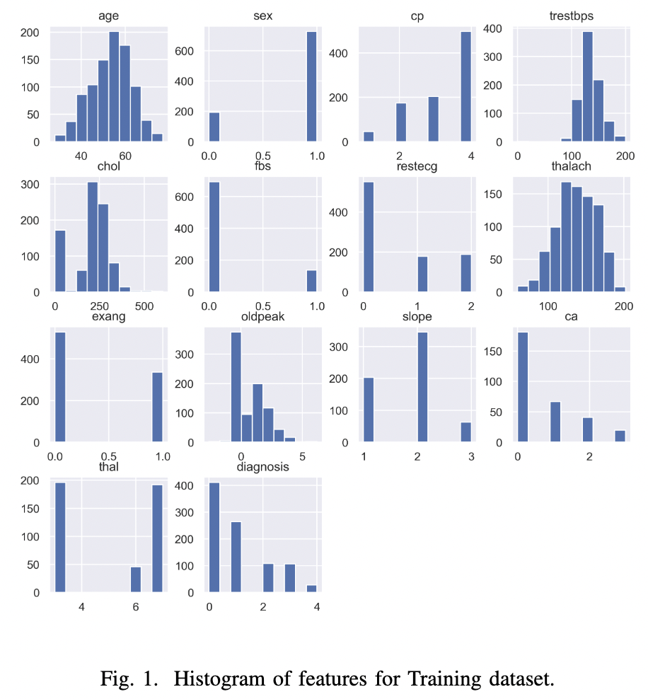
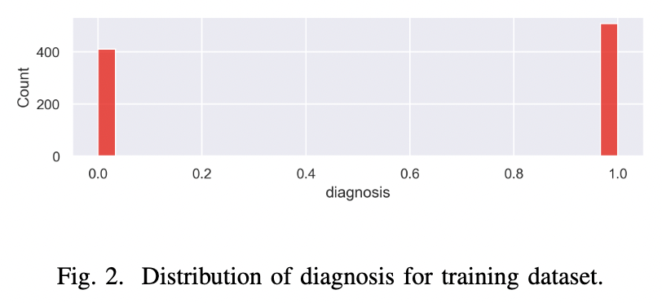
Dataset Description
Predicting Heart Disease using Machine Learning Techniques: A Comparative Analysis
Collected from multiple hospitals and institutes
14 key variables related to heart disease
Contains missing data and varying ranges
Challenges & Tasks:
Handling missing data.
Ensuring dataset integrity for accurate models.
HCI 2022-2023
‹#›

Slide 5
Data Preprocessing
Predicting Heart Disease using Machine Learning Techniques: A Comparative Analysis
FEATURE SELECTION
MISSING VALUES
NORMALIZATION
TRAIN-TEST SPLIT
13/75 features
DISCRETE
80/20 split
New
category (5)
One-hot encoding
75 features
34 features
Median
Standardization
(StandardScaler)
CONTINUOUS
HCI 2022-2023
‹#›

Slide 6
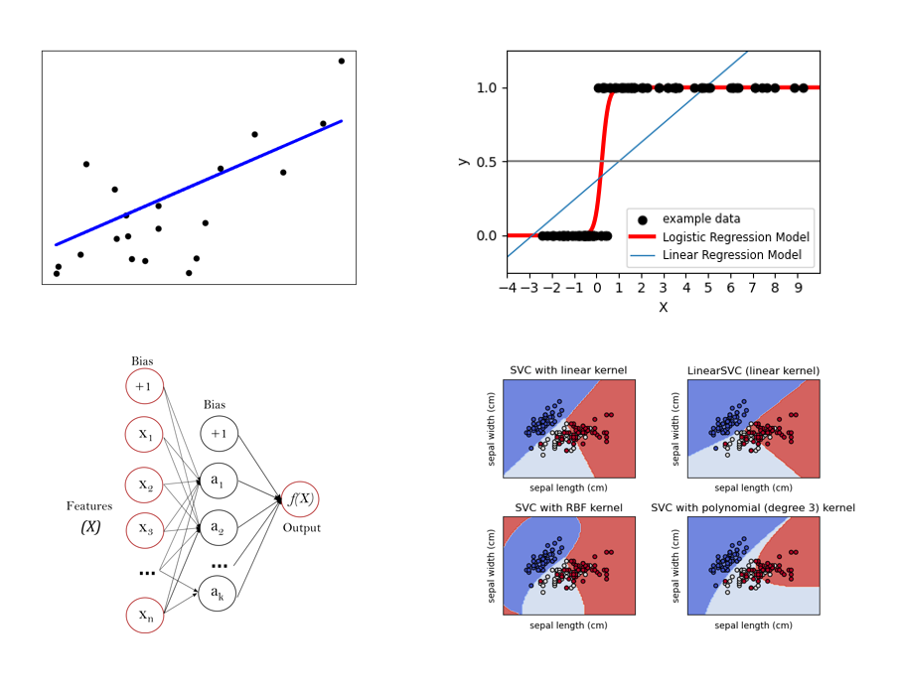
Models
Predicting Heart Disease using Machine Learning Techniques: A Comparative Analysis
LINEAR REGRESSION
LOGISTIC REGRESSION
SUPPORT VECTOR MACHINE
NEURAL NETWORK
HCI 2022-2023
‹#›

Slide 7
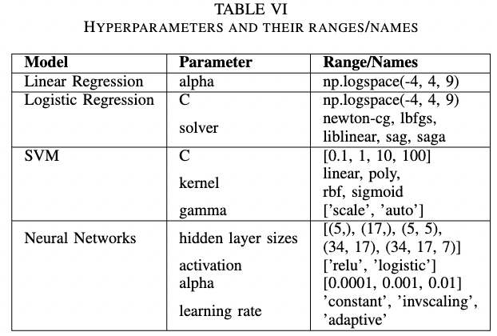
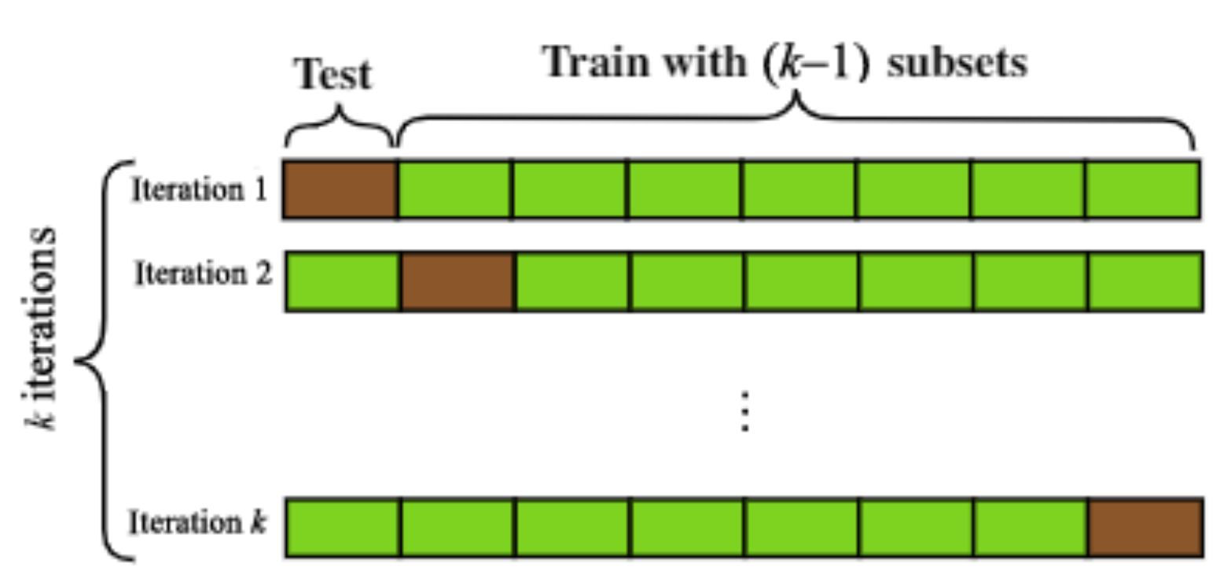
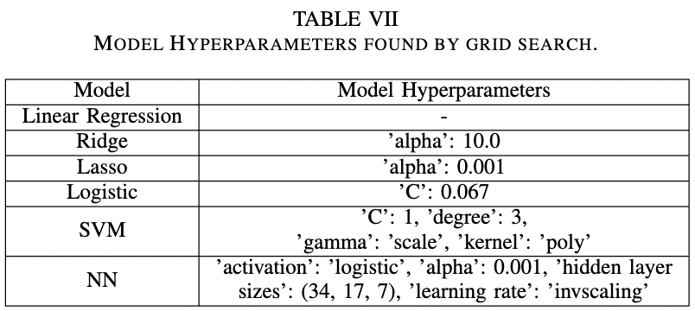
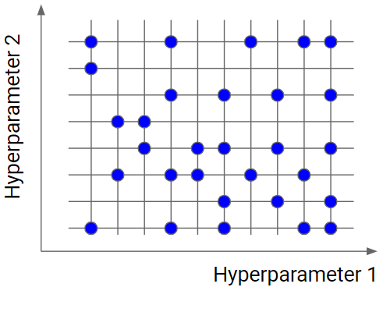
Model Selection and Hyperparameter Tuning
Predicting Heart Disease using Machine Learning Techniques: A Comparative Analysis
DEFINE SEARCH SPACE
PERFORM K-FOLD & GRID SEARCH
RECEIVE OPTIMAL HYPERPARAMETERS
HCI 2022-2023
‹#›

Slide 8
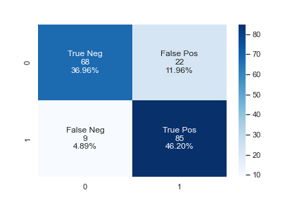




Model Performance Metrics
Predicting Heart Disease using Machine Learning Techniques: A Comparative Analysis
Exemplary confusion matrix
The accuracy score is very important for medical applications. For heart disease predictions this metric ensures that we correctly label the people with and without the disease.
HCI 2022-2023
‹#›

Slide 9


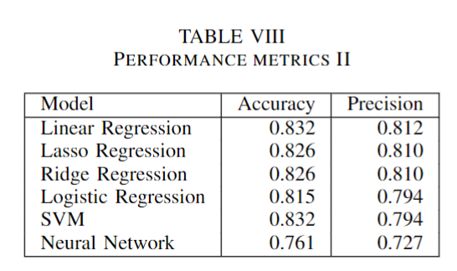

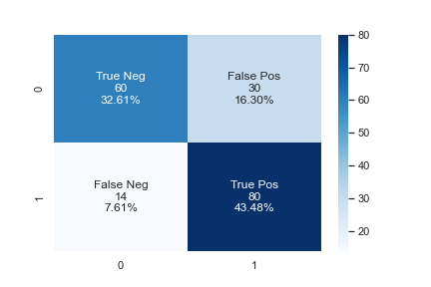
Comparison of Models
Predicting Heart Disease using Machine Learning Techniques: A Comparative Analysis
Confusion matrices of the models
Comparison of accuracy
Visualization of results for Linear, Logistic, SVM and NN Model
HCI 2022-2023
‹#›

Slide 10
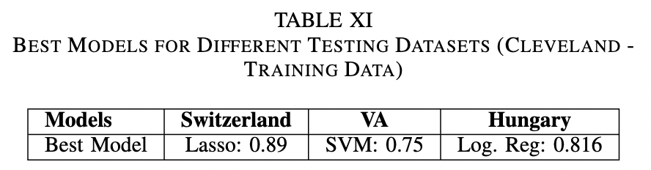
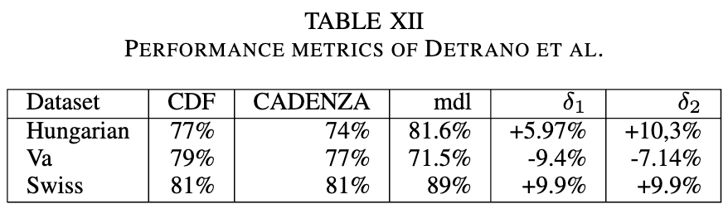
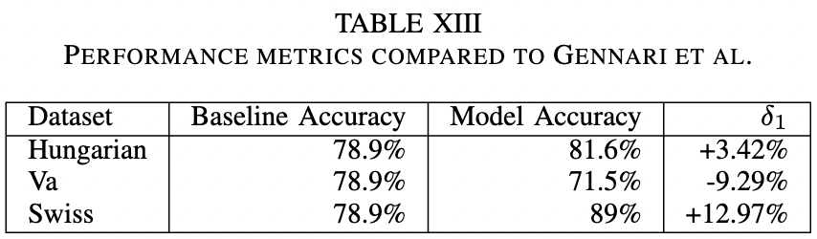
Comparison With Other Work
Predicting Heart Disease using Machine Learning Techniques: A Comparative Analysis
HCI 2022-2023
‹#›

Slide 11
Discussion and Conclusion
Predicting Heart Disease using Machine Learning Techniques: A Comparative Analysis
Prediction model outperforms existing methods.
CRUCIAL FACTORS FOR MODEL SUCCESS
LIMITATIONS
FUTURE RESEARCH
appropriate model selection
hyperparameter optimization
feature selection
data preprocessing
missing data
small dataset size
small model complexity in relation to dataset size
grid search limitations
data collection
advanced optimization techniques
sophisticated feature selection
addressing biases
HCI 2022-2023
‹#›

Slide 12
References
Predicting Heart Disease using Machine Learning Techniques: A Comparative Analysis
1] National Center for Chronic Disease Prevention and Health Promotion, Division for Heart Disease and Stroke Prevention, Ed., “About heart disease,” Centers for Disease Control and Prevention, 21-Mar-2023. [On- line]. Available: https://www.cdc.gov/heartdisease/about.htm. [Accessed: 09-Apr-2023].
[2] U. S. G. A. Office, “Machine Learning’s potential to improve medical diagnosis,” U.S. GAO, 16-Mar-2023. [Online]. Available: https://www.gao.gov/blog/machine-learnings-potential-improve-medical-diagnosis [Accessed: 09-Apr-2023].
[3] M. M. Ahsan, S. A. Luna, and Z. Siddique, “Machine-Learning-Based Disease Diagnosis: A Comprehensive Review,” Healthcare, vol. 10, no. 3. MDPI AG, p. 541, Mar. 15, 2022. doi: 10.3390/healthcare10030541.
[4] D. Dua and C. Graff, ”UCI Machine Learning Repository,” [Online]. Available: http://archive.ics.uci.edu/ml. [Accessed: Apr. 9, 2023].
[5] S. Singh, “Importance of pre-processing in machine learning,” KDnuggets, 20-Feb-2023. [Online]. Available: https://www.kdnuggets.com/2023/02/importance-preprocessing-machine-learning.html#::text=In%20conclusion%2C%20preprocessing%20data%20before,the%20interpretability%20of%20the%20model. [Accessed: 09-Apr-2023].
[6] T. A. I. Team, “Machine learning standardization (Z-score normalization) with...,” Towards AI, 15-Jul-2020. [Online]. Available: https://towardsai.net/p/machine-learning/machine-learning-standardization-z-score-normalization-with-mathematics. [Accessed: 09-Apr-2023].
[7] Howell, E. (2022, December 28). One hot encoding simply explained. Medium. Retrieved April 9, 2023, from https://pub.towardsai.net/one- hot-encoding-simply-explained-748a33b5f399
[8] S. Shalev-Shwartz and S. Ben-David, Understanding Machine Learning - From Theory to Algorithms. Cambridge University Press, 2014, p. I–XVI, 1-397.
[9] E. A. A. Alaoui, S. C. K. Tekouabou, S. Hartini, Z. Rustam, H. Silkan, and S. Agoujil, “Improvement in automated diagnosis of soft tissues tumors using machine learning,” Big Data Mining and Analytics, vol. 4, no. 1. Tsinghua University Press, pp. 33–46, Mar. 2021. Doi: 10.26599/bdma.2020.9020023.
[10] scikit-learn, “Learn,” scikit. [Online]. Available: https://scikit-learn.org/stable/index.html. [Accessed: 12-Apr-2023].
[11] J. H. Gennari, P. Langley, and D. Fisher, “Models of incremental concept formation,” Artificial Intelligence, vol. 40, no. 1–3. Elsevier BV, pp. 11–61, Sep. 1989. doi: 10.1016/0004-3702(89)90046-5.
[12] R. Detrano et al., “International application of a new probability algorithm for the diagnosis of coronary artery disease,” The American Journal of Cardiology, vol. 64, no. 5. Elsevier BV, pp. 304–310, Aug. 1989. doi: 10.1016/0002-9149(89)90524-9.
HCI 2022-2023
‹#›

